Slide 1
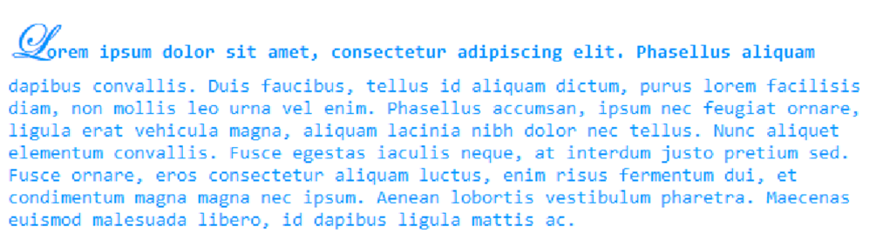
Create the following web page
Fonts used: Consolas, Edwardian Script ITC
Color: #0094ff

Slide 2
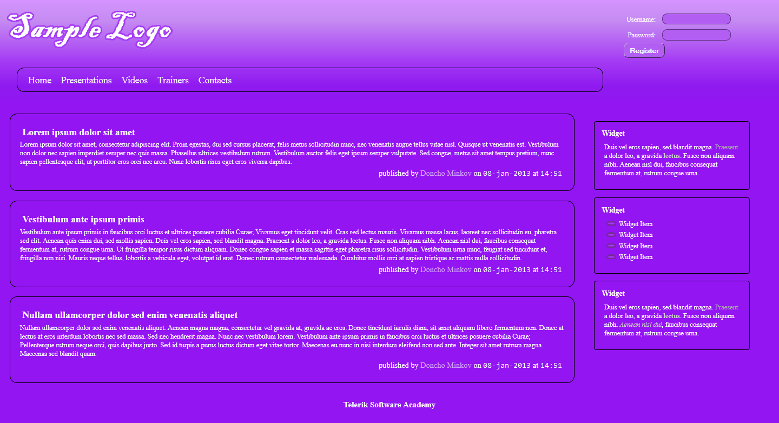
You are given prewritten HTML and CSS code. Expand this code to make the web page to look exactly like the image below:

Slide 3
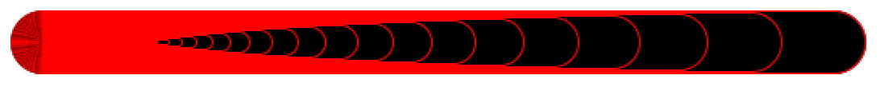
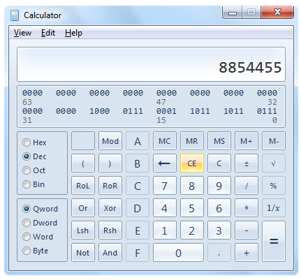
Create the following web page by using 60 nested div elements
Create a web page that looks like the Windows calculator in Programmer view
It should look exactly the
same
Implement hover effects
for the buttons
The calculator should not
have any functionality

